Slide 1
Role of System Analyst.

Slide 2
Definition:
A System Analyst is a professional who studies, designs, and improves information systems to meet business needs.
They act as a bridge between users and developers, ensuring that system solutions fulfill organizational goals.
In according to Random House Dictionary –
A person who conducts a methodical study and evaluation of an activity such as a business to identify its desired objectives in order to determine procedures by which these objectives can be gained.
Notes:
For example, a system analyst may analyze how a university handles student data and suggest an automated software solution to manage admissions and results.

Slide 3
Historical Perspective of System Analyst
War Effect:
Pre–World War I Industrial Landscape
Factories were labor-intensive and relied heavily on manual work.
Automation began to change production methods, making goods faster, cheaper, and more efficient.
The rise of labor unions and increased wages created demand for analysts.
Analysts were needed to improve working conditions and establish standards and incentive systems.
They also developed training programs and methods to enhance workforce development.
Post–World War II Developments (1950s–1960s)
The federal government started stockpiling military weapons.
Analysts conducted cost/benefit analyses to evaluate weapon systems.
Inventory-control techniques were used to determine optimal weapon usage and quantities.

Slide 4
Historical Perspective of System Analyst
War Effect:
Systems developed during the war era include
Radar system.
Early computers.
Cryptographic Machines.
Inventory control systems.
Operations Research.
Mass Production of Penicillin.
These innovations were driven by military needs and later influenced civilian technologies.

Slide 5
Historical Perspective of System Analyst
1950s–1960s:
Computers used mainly for payroll and record keeping.
Programmers handled both analysis and programming tasks.
1970s–1980s:
Growing need for professionals to link business needs with technical solutions.
System Analyst role formally recognized.
Structured analysis and design methods introduced.

Slide 6
Historical Perspective of System Analyst
1990s:
Expansion of databases and personal computers.
Analysts focused on system integration and decision-support systems.
2000s–Present:
Use of object-oriented, agile, and cloud-based approaches.
Analysts act as technology planners and digital transformation advisors.
Greater focus on business strategy and user experience.

Slide 7
What Does It Take to Do Systems Analysis?
A System Analyst must have a balanced combination of interpersonal and technical skills.
Both are essential for the successful development, design, and implementation of systems.
Interpersonal skills deal with people, relationships, and communication within the business.
Technical skills focus on methods, tools, and techniques used in systems and computer analysis.
Together, they help analysts understand user needs, solve problems, and deliver effective solutions.

Slide 8
Interpersonal Skills of a System Analyst
Communication:
Ability to speak the user’s language and build understanding across managerial levels.
Involves listening, discussing, and creating an open communication climate.
Avoids defensive or excessive documentation that blocks collaboration.
Understanding:
Ability to identify problems, assess their impact, and align solutions with company goals.
Shows sensitivity to how systems affect people and workflow.
Teaching:
Educating users on system operation and providing continuous support.
Helps users adapt to new systems confidently.
Selling:
Promoting system ideas and convincing users to adopt technological solutions.
Builds enthusiasm and acceptance for innovation

Slide 9
Technical Skills of a System Analyst
Creativity:
Transforming user ideas into workable system models and design alternatives.
Problem Solving:
Breaking complex issues into manageable parts and finding best-fit solutions.
Project Management:
Managing time, cost, and resources; coordinating teamwork effectively.
Dynamic Interface:
Integrating both technical and non-technical aspects in system design.
Questioning Attitude:
Continuously exploring “what, why, when, where, who, and how” of system operations.
Knowledge Base:
Sound understanding of computer fundamentals and business processes.

Slide 10
Application of Skills in System Development Phases
Analysis Phase:
High focus on interpersonal skills — gathering user requirements and translating them into system needs.
Design Phase:
More emphasis on technical skills — creating system architecture and design details.
Implementation Phase:
Combination of both skills — testing, user training, and system transition.
Maintenance Phase:
Limited analyst involvement unless new or unexpected issues arise.

Slide 11
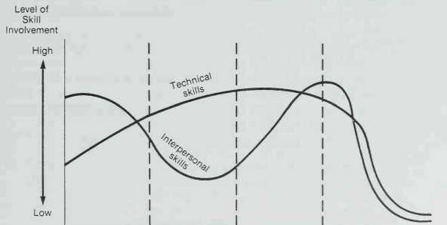
Application of Skills in System Development Phases
Analysis
Design
Implementation
Maintenance
Figure-01: Interpersonal and Technical Skills Necessary in System Development

Slide 12
How Does an Analyst Acquire These Skills?
A System Analyst develops essential skills through education, experience, and personality traits.
Most analysts are college graduates majoring in:
Accounting
Management
Information Systems
The Information Systems field now includes specialized courses such as:
Systems Analysis
Project Management
Database Design
Over 30 universities offer advanced (doctoral) programs in Systems Analysis and Design.

Slide 13
Academic Background and Experience
Systems Theory & Organizational Behavior:
Helps understand how systems operate within organizations.
Knowledge of Application Areas:
Financial accounting, marketing, personnel management, production control, etc.
Competence in System Tools:
Practical experience with programming, database languages, and methodologies.
Hardware & Software Experience:
Understanding specifications aids in system and technology selection.

Slide 14
Personal Attributes of a System Analyst
Authority: Confidence to lead and make decisions under pressure.
Communication Skills: Ability to express ideas clearly and guide users logically.
Creativity: Willingness to explore new methods and innovative solutions.
Responsibility: Ownership of decisions and accountability for outcomes.
Varied Skills: Flexibility to manage diverse projects and adapt to change.

Slide 15
The Multifaceted Role of the System Analyst
A System Analyst performs multiple roles to ensure successful system development and user satisfaction. These include: Change Agent, Investigator, Monitor, Architect, Psychologist, Salesperson, Motivator, and Politician. Each role requires different skills, attitudes, and approaches to deal with people, technology, and organizations.

Slide 16
The Multifaceted Role of the System Analyst-Key roles
Change Agent
Introduces and manages organizational change through new systems.
Encourages user participation to gain acceptance.
2. Investigator and Monitor
Investigator: Identifies system problems and uncovers hidden issues affecting performance.
Monitor: Tracks project time, cost, and quality to prevent delays or overruns.
3. Architect
Translates user requirements into technical system design.
Acts as a bridge between users’ ideas and programmers’ implementation.
Notes:
Change Agent:
1. Nokia
Reason: Failed to adapt quickly to the smartphone revolution and touchscreen technology.
2. Yahoo
Reason: Failed to evolve its search engine and advertising model.
3. BlackBerry
Reason: Relied too much on physical keyboards and ignored the app-based smartphone ecosystem.
Investigator task to Investigate:
Interview users and stakeholders to understand workflow and pain points.
Review complaints, reports, or performance data.
Conduct interviews, surveys, or questionnaires.
Determine root causes rather than just symptoms.
Identify the gap between “what is” and “what should be.”
Task of Motivator:
People feel motivated when they know their task has value or purpose.
When employees are trusted to decide how to complete a task, they feel ownership and responsibility.
Seeing the results of one’s work increases motivation.
When a person’s successful completion of a task is appreciated, it boosts morale and encourages further effort.

Slide 17
The Multifaceted Role of the System Analyst-Key roles
4. Psychologist
Understands human behavior and workplace relationships.
Handles emotions and resistance gracefully.
5. Salesperson
“Sells” the system idea to users and management at every stage.
Uses persuasion and presentation skills to build confidence.
6. Motivator
Encourages users to accept and use the new system effectively.
Provides training and continuous support after implementation.
7. Politician
Uses diplomacy and negotiation to gain user and management support.
Strives to balance conflicting interests and maintain harmony.

Slide 18
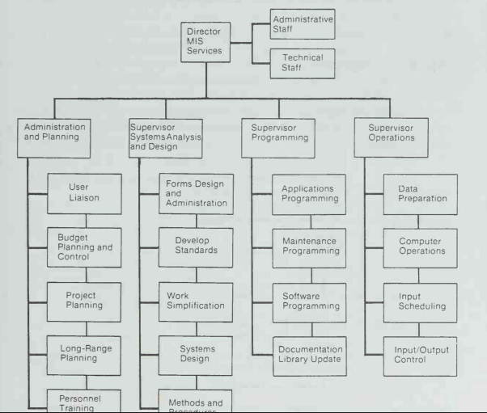
THE PLACE OF THE ANALYST IN THE MIS ORGANIZATION
The MIS Organization
Figure -02: General Organization Chart of an MIS Division

Slide 19
Primary Functions of an MIS Facility
The functional requirements of an MIS facility center around the following areas: administration, systems analysis and design, programming, and operations.
Administration is represented by four activities:
User liaison which handles the changing needs of the user and user-systems relationships.
Long-range planning, which includes personnel selection, recruitment, application development, and planning for anticipated changes in hardware and software.
Budget planning and control of the entire MIS division.
Personnel administration and training for upgrading employee skills.

Slide 20
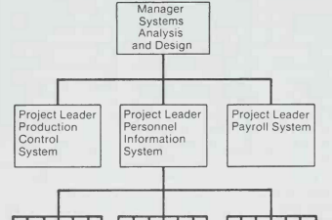
Primary Functions of an MIS Facility
2. Systems analysis and design may be organized as project-oriented, pool-oriented, or functional.
In a project-oriented arrangement a team of analysts is formed to work on one project. As shown in Figure 3, each team has project leader who reports directly to the systems manager. This arrangement is typical of smaller installations that handle limited projects.
SA
SA
SA
Figure 3: Project Oriented

Slide 21
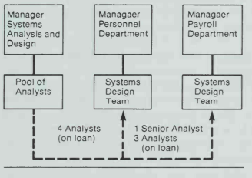
Primary Functions of an MIS Facility
A pool-oriented arrangement is a system development approach where analysts are grouped in a common pool and temporarily assigned to various departments based on project needs.
Analysts are assigned to a department for a specific project.
They report to the department manager during the project.
After completing the task, they return to the analyst pool.
This approach ensures flexibility, user involvement, and better system support.
Figure -04: Pool Oriented

Slide 22
Difference between Project Oriented Structure and Pool Oriented Structure
Key Points | Project-Oriented Structure | Pool-Oriented Structure
Basic Concept | Separate teams of analysts are formed for each project. | Analysts are kept in a central pool and temporarily assigned to departments as needed.
Analyst Assignment | Analysts are permanently assigned to one specific project until it ends. | Analysts are temporarily “on loan” from the pool to different projects or departments.
Reporting Authority | Analysts report to their Project Leader. | Analysts report to the Department Manager during the project and then return to the pool.
Flexibility | Less flexible — analysts stay fixed with one project. | More flexible — analysts can move between projects as required.
Resource Utilization | May lead to duplication of effort and underuse of some skills. | Better utilization — analysts are shared among departments.
 | A software company forms a dedicated team for each client project. | A bank has one central IT analyst pool serving HR, Accounts, and Loan departments.

Slide 23
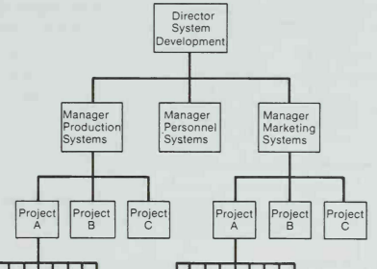
Primary Functions of an MIS Facility
In a functional structure of analysis, analysts are divided into separate teams, and each team works on a specific system area of the organization.
For example:
A Personnel Systems Team handles employee-related systems.
A Production Systems Team manages production-related systems.
A Marketing Systems Team works on sales and marketing systems.
Each team has its own manager, and all team managers report to the Director of System Development.
SA
SA
Figure 5: Functional Structure

Slide 24
Primary Functions of an MIS Facility
3.Programming work is divided into three areas:
Applications – Develop new systems and applications.
Software – Modify compilers or software packages.
Maintenance – Make updates and fixes to keep systems running.
Programmers can work in two ways:
Pool Approach – All programmers belong to one pool and report to a supervisor; each works on different programs individually.
Team Approach – Programmers work in a team on one specific project.

Slide 25
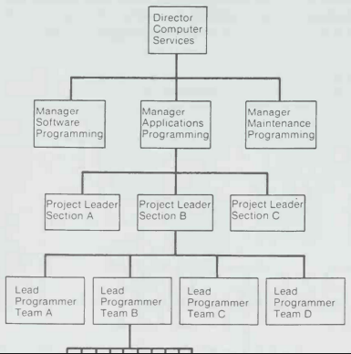
Primary Functions of an MIS Facility
In the team approach:
Programmers report to a Lead Programmer (Team Leader).
The team leader reports to the Project Leader.
The project leader (section head) supervises several teams and reports to the Manager of the Programming Area.
Programmer
Figure 6: Team Approach

Slide 26
Primary Functions of an MIS Facility
3.Operations manages the day-to-day running of computer systems.
It includes tasks like:
Job scheduling (deciding when programs or tasks will run)
Managing supplies inventory (keeping track of necessary materials)
Supporting programming activities
Maintaining the data library (storing and organizing data files)
All these functions are coordinated with systems design and programming.
Everything works together under a master plan to ensure smooth system operation.

